Slide 1
Technical Writing:
Models for Writing Informative Abstracts
Dr. Gayle W. Griggs

Slide 2
Introduction
Abstract definitions
Abstract purpose
Abstracts in the disciplines
Informative versus Indicative abstracts
Abstract basics
Writing and evaluating the abstract
Effective titles

Slide 3
Abstract Definitions: Which is correct?
(The American Heritage Dictionary)
--adj. Considered apart from concrete existence: an abstract concept
--adj. Not applied or practical
--adj. Difficult to understand; abstruse
--adj. Considered without reference to a specific instance
--n. A summary or condensation

Slide 4
American National Standard Institute (ANSI)/ National Information Standards Institute (NISO)
Abstract: “A brief and objective representation of a document or an oral presentation” (p. 3).

Slide 5
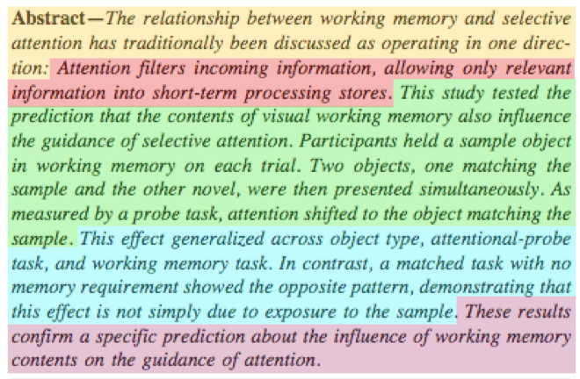
A good abstract is a well-written stand-alone statement that summarizes a document’s content concisely and stimulates the reader’s interest.

Slide 6
Purpose
(Albarran, 2007)
Directed to a specific audience
Prepared with a particular focus
An abstract is written to persuade readers that the “proposed work is of a high standard, sufficiently rigorous, [and] makes a distinct contribution” (p. 570).

Slide 7
Abstracts in the Disciplines
(The University of Adelaide, 2009)
Informative: Science, engineering, and psychology
    Background & purpose, method, findings/results, conclusion
Descriptive: Humanities and social sciences
    Background, purpose, focus, overview

Slide 8
Informative Abstract
(Albarran, 2007; ANSI/NISO, 1997; Day, 1994)
For scientific or technical documents, e.g. experimental research, reports, surveys
  condenses “purpose, methodology, results, and conclusion” (NISO, 1996,p. 3)
  serves as the heading in journals
  “supplants the need for reading the full paper” (Day, 1994)

Slide 9
Indicative (or Descriptive) Abstract
(Albarran, 2007; ANSI/NISO, 1997; Day, 1994)
  “For less-structured documents” (ANSI/NISO, 1997, p. 3)
    reviews, reports, government documents, books, directories, conference proceedings, lists
  not used as the heading in journals
  written for papers not containing methodology or results

Slide 10
Informative Abstract Format
Note: Follow the parameters established by the publication or conference
“When writing the abstract, remember that it will be published by itself, and should be self-contained.” (McGirr, 1973).
Directly after the title
One single paragraph
Five to ten sentences
A specific word limit

Slide 11
Abstract Lengths
(ANSI/NISO, 1997, p. 4)
Journal articles: 250 words
Notes, short communications: 100 words
Editorials, letters to editors: 30 words
Long monographs: 300 words or a single page

Slide 12
Abstract Basics
(ANSI/NISO, 1997; Day & Gastel, 2011)
Summarize the main sections of the study
Define the contents of the paper
Employ clear, precise, and concise language
Use direct sentence structure (active verbs)
Write in the past tense
Integrate transitional phrases and words
Omit references and footnotes
Notes:
Abstracts will be read by 50 to 500 times more people than the full paper

Slide 13
The Informative Abstract
(ANSI/NISO, 1997, p. 4)
Presents a synopsis of the project
  Purpose: Objectives and reason for the study
  Methodology: Brief report of techniques/approaches
  Results: Concise account of most important discoveries
  Conclusions: Implications/Recommendations
  Collateral/Other Information: Findings or relevant information outside of subject area
Notes:
Abstracts will be read by 50 to 500 times more people than the full paper

Slide 14
Appealing Abstracts
(ANSI/NISO, 1997, p. 2)
An appealing abstract enables readers to
identify the document’s subject matter quickly
determine its relevance to their interests
decide if they need to read the entire paper

Slide 15

Writing the Abstract
(Kretchmer & Blanco, 2008)
Exploration
List major objectives and conclusions
Jot down a list of keywords
List major results
Writing
Write one paragraph with 1, 2, and 3
In the first sentence, state hypothesis or method used

Slide 16
Writing the Abstract
(Kretchmer & Blanco, 2008)
Leave out detailed information
Avoid wordiness
Include essential information concisely
Follow specified guidelines & standards
Verify that the abstract is clear to someone not familiar with the subject

Slide 17
Good Abstracts Answer
(ERS, 2010)
5 Questions
Why is it important? –Offers a brief background and summary of information.
What did it try to do? – Provides principal purpose and objectives.
What did it do? – Presents core methods & design.
What was learned/found? – Presents chief knowledge/findings.
What does it mean? – Explains findings’ importance in one sentence.

Slide 18
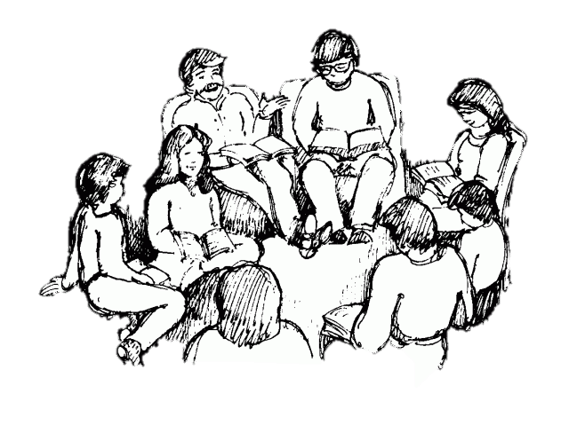
Group Activity
In groups (3+ students), read one or more abstracts. Identify and discuss how each abstract answers the following 5 questions:
    Why is it important?
    What did it try to do?
    What did it do?
    What was learned or found?
    What does it mean?

Slide 19

Titles Attract the Reader
(NCSU, 2002)
Six to twelve words
No abbreviations
No Latin names (if available in English)
Keywords
No ambiguous words and jargon

Slide 20
Effective Titles
(Elliot, 2008)
Brief and easily remembered
Do not include “qualitative statements about the work being reported” (9)
Place “keywords first” to attract attention (6)
Omit people or place’s names (11)

Slide 21
Research Paper Titles
(Fathalla & Fathalla, 2004)
A good title may include the following:
  Keywords
  Techniques or designs
  Subject studied
  Results
  Interpretations

Slide 22
Group Activity
Review the titles of research papers.
In groups (3+), identify and discuss their effectiveness in following the appropriate criteria.

Slide 23
Summary
A concise stand-alone statement directed to a specific audience.
Presents a synopsis of the project
Appeals to the reader
Includes keywords and essential information
Written in the past tense using active verbs
Observes the publication’s specific criteria

Slide 24
References
Albarran, J. (Nov. 2007). Planning, developing, and writing an effective conference abstract. British Journal of Cardiac Nursing, 2(11), 570-572.
ANSI/NISO. (1997). Guidelines for abstracts, American National Standards Institute/ National Information Standards Organization (pp. i.-14). Bethesda, MD: NISO Press.
Day, R. A., & Gastel, B. (2011). How to prepare an abstract How to write and publish a scientific paper (7th ed., pp. 53-58). Santa Barbara: Greenwood.
Elliott, C. M. (2008). Writing effective titles [PowerPoint Presentation]. Urbana-Champain: The Board of Trustees of the University of Illinios.
European Respiratory Society (2010). How to write a good abstract. 2012(May 17). Retrieved from http://erscongress2010.org/1063-abstracts.htm
Fathalla, M. F., & Fathalla, M. M. F. (2004). A practical guide for health researchers. from http://applications.emro.who.int/dsaf/dsa237.pdf

Slide 25
References (continued)
Koopman, P. (October 1997). How to write an abstract. Retrieved June 3, 2012, from www.ece.cmu.edu/~koopman/essays/abstract.html
Kretchmer, P., & Blanco, P. (2008). Ten steps to writing an effective abstract. Retrieved 15 June, 2012, from http://www.sfedit.net/abstract.pdf
Leahy, R. (1992). Twenty titles for the writer. College Composition and Communication, 43(4), 516-519.
McGirr, C. J. (1973). Guidelines for abstracting. Technical Communication, 25(22), 25.
North Carolina State University-Urbana-Champain. (2002). Be a better author. Retrieved from http://www.ncsu.edu/project/posters/NewSite/documents/betterauthor.pdf
Pritchard, D. R. (1994). The American Heritage Dictionary. In D. R. Pritchard (Ed.), The American Heritage Dictionary (3rd ed.). New York: Laurel.

